Slide 1
Array In C#
Presented By:
Er.Sudan Prajapati

Slide 2
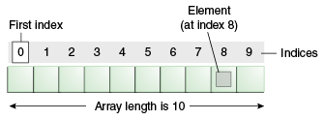
Array
An array is a container object that holds a fixed number of values of a single type.
The length of an array is established when the array is created.
After creation, its length is fixed.
Each item in an array is called an element, and each element is accessed by its numerical index.

Slide 3
Declaring Array Variables
Declare an array variable by specifying the type of data to be stored, followed by square brackets [].
dataType[] variableName;
Or dataType variableName [];
Declare a variable for an array of integers:
int[] nums;
Declare a variable for an array of String objects:
String[] names;

Slide 4
Creating Arrays
You can create an array by using the new operator with the following syntax:
dataType [] array = new dataType[arraySize]
The above statement does two things:
It creates an array using new dataType[arraySize]
Constructs a new array object with array Size int elements, all initialized to 0, and stores the reference into array.

Slide 5
Initializing Arrays
An array can be initialized when it is created
The notation looks like this:
String[] names = { "Joe", "Jane", "Herkimer" }; or
String[] names = new String[] {"Joe", "Jane", "Herkimer" };
This automatically creates an array of length 3, because there were 3 items supplied.
int[] nums = new int[] { 2, 4, 6, 8, 10, 12 };
What is the length of this array??\
If a new array is being assigned to an existing variable, you cannot use the shorter variant, you must use the new keyword and the data type:
String[] names;
names = new String[] {"Joe", "Jane", "Herkimer" };

Slide 6
Initializing Arrays
An array can be initialized when it is created
The notation looks like this:
String[] names = { "Joe", "Jane", "Herkimer" }; or
String[] names = new String[] {"Joe", "Jane", "Herkimer" };
This automatically creates an array of length 3, because there were 3 items supplied.
int[] nums = new int[] { 2, 4, 6, 8, 10, 12 };
What is the length of this array??
If a new array is being assigned to an existing variable, you cannot use the shorter variant, you must use the new keyword and the data type:
String[] names;
names = new String[] {"Joe", "Jane", "Herkimer" };

Slide 7
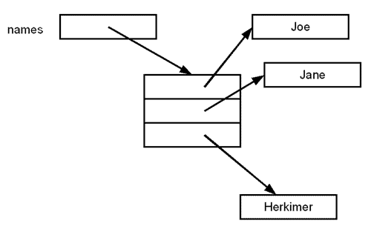
Initializing Arrays

Slide 8
Working With Arrays
Array elements are accessed through the their array index:
The index is the element number, placed within brackets.
Elements are numbered from 0 to one less than the specified size.
String[] names = new String[3];
The valid elements are 0, 1, and 2.
names[0] = "Sam";
names[1] = "Sue";
names[2] = "Mary";
You could access array elements in a for loop with:
for (int i = 0; i < 3; i++) System.out.println(names[i]);
better programming practice would be to use length property:
for (int i = 0; i < names.length; i++) System.out.println(names[i]);

Slide 9
Assignment
Define the size of array from the user and assign the values to element.
Print the assigned value in while loop.
Define any data type array of size 5 take the input from the user and print it.
Take the size 10 array of any data type assign the value then while printing when you reach the value 5 terminate the loop;
Take integer type array of size 5 assign the values and print the sum of the array

